Slide 1
Facebook Live Sellers Dataset Analysis
By Kaustav Kamakhi Patro

Slide 2
What the dataset reveals?

Slide 3
Facebook Live Sellers dataset
This data set contains details about Facebook pages of 10 Thai fashion and cosmetics retail sellers.
The dataset has individual details on each status posts about it’s time of upload and engagement metrics like number of reactions, likes, shares.
When carefully explored we can see patterns between different engagement metrics.

Slide 4
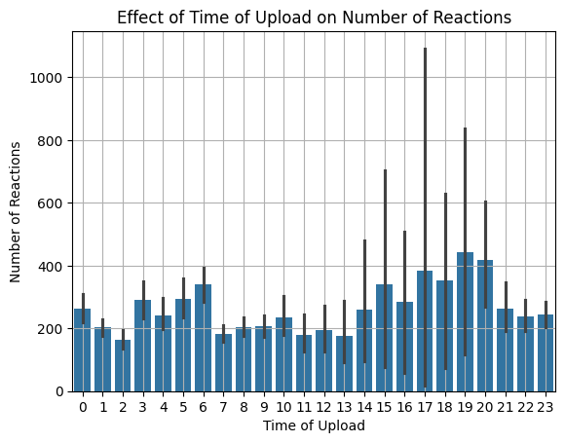
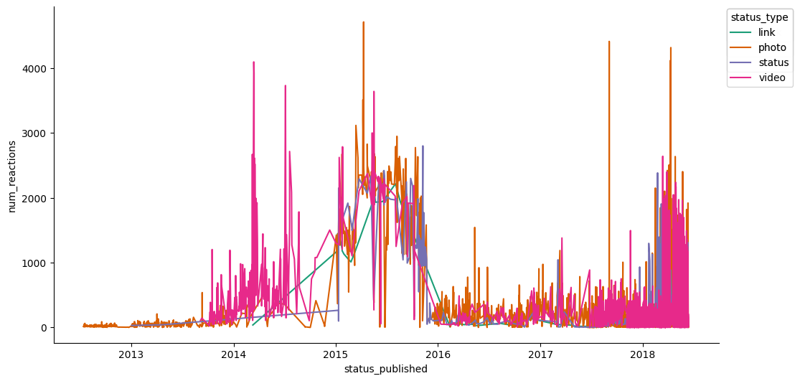
Analysis
The time of status uploads largely dictates the number of reaction on the post. This shows that viewers are more likely to react on status posts during their leisure time which here is 3pm to 8pm.

Slide 5
Analysis
Live sellers upload mostly photos and videos and these kind of status post receive the most amount of reaction from viewers.

Slide 6
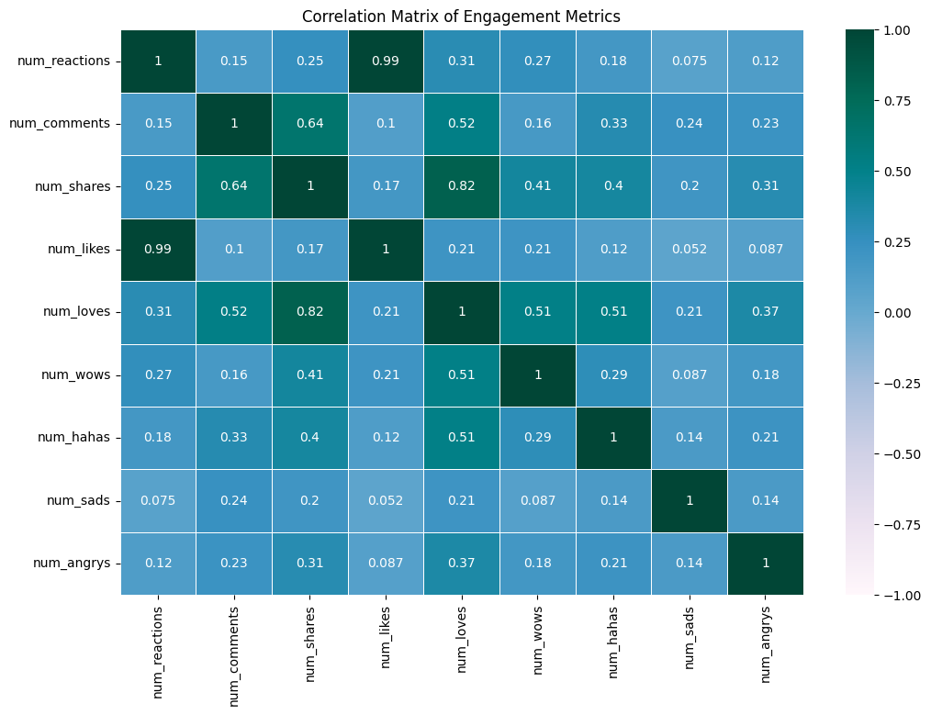
Analysis
There’s a strong correlation between number of likes and number of reactions. This shows that viewers who react are most likely to like the status post.
Viewers also tend to share the status post they love.

Slide 7
Analysis
Number of reactions are more status than link. Videos and photos have lesser number of reaction reaction.
Number of comments are usually highest for videos.
Videos are the most shared form of status post.
In conclusion, Videos garner more engagement.

Slide 8
THANK YOU

